Slide 1


The Power of Promiscuous Pairing
Carol Treat Morton
High-Tech Anthropologist®
Thomas Piggott
High-Tech Anthropologist®

Slide 2
But first, who are we?

Slide 3

Pairing is not a new concept

Slide 4
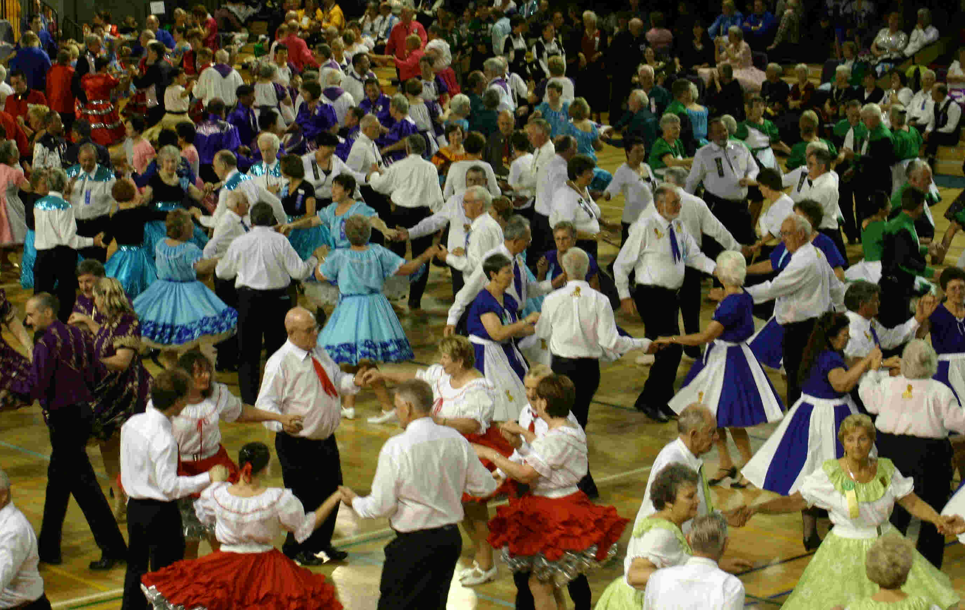
Switching partners isn’t new either

Slide 5
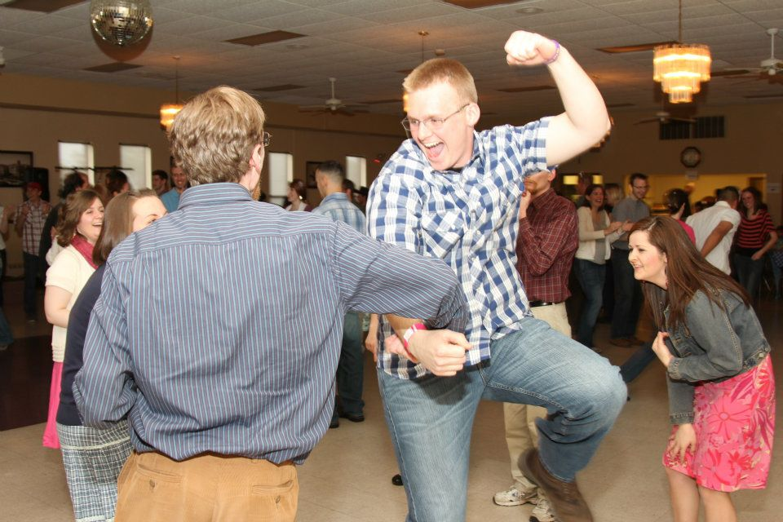

And neither one is unique to software

Slide 6
But why pair at all?
No project is an island; software can’t be built or perform in isolation.
~Andy Hunt, Pragmatic Thinking & Learning: Refactor Your Wetware

Slide 7
Pairing is no panacea
“Man, I’ll be glad when this stupid fad is over with.”
-- comment by “Slowly but Surly” to Huffington Post article, “Pair Programming: Facebook Makes Some Employees Share Computers, Desks”, 8/27/2012

Slide 8

So ask yourself: What problem am I really trying to solve?

Slide 9
The problems we faced…
Our clients demanded high levels of flexibility in staffing
Client problem research needed broader technical and design expertise
As High-Tech Anthropology® engagement demand grew, resources become scarce

Slide 10
Promiscuous Pairing
So we ran the experiment of
Pairing beyond “traditional” iteration-based pairing
Switching partners “frequently”
Not just for developers
Pairing across roles / skills
Always, always pairing
Thank you to Arlo Belshee who wrote a paper, Promiscuous Pairing and Beginner’s Mind: Embrace Inexperience, describing experiments in switching developer pairs every 90 minutes

Slide 11
Our “rules” for promiscuous pairing
They’re the same as regular pairing!
Focus on solving the problem
Always make your partner look good
Everybody should be willing to pair with anybody
Give and receive feedback freely and frequently
People in a pair act as both teacher and student

Slide 12
Why we pair promiscuously
Benefits to the individual:
You learn to trust your whole team
You learn to make mistakes faster
You become adaptable to different work styles and personalities and then learn to appreciate those differences

Slide 13
Why we pair promiscuously
Benefits to the project:
Speed up knowledge transfer
Instant and continuous feedback from a broader base
Increase supply of fresh perspectives
Continually articulate and refine design decisions with the team

Slide 14
Why we pair promiscuously
Benefits to the organization:
Fosters a learning culture
Prevents building towers of knowledge
Builds trusting relationships
Simplifies and facilitates onboarding new people
Flushes out performance issues

Slide 15
Costs of pairing
Loss of freedom
You are accountable to your partner
Loss of personal ownership
Nothing you do belongs to just you
Vulnerable
Must admit when you’re lost
Exhausting
You have to talk out loud about everything

Slide 16
You know you’ve been too promiscuous when…
Knowledge transfer degrades so that bringing a new partner up to speed is more costly than the value it brings
Knowledge gaps interfere with developing a clear, shared model
Your ability to focus on the task at hand is confused by other projects

Slide 17
Promiscuous Pairing Exercise
Setup: - Teams of 6
- 3 pairs per team
- Different colored marker per person
- 1 piece of paper per pair
Premise: Design a house

Slide 18
Round 1: Design a House
Promiscuous Pairing Exercise
Activity: - Grab a pair partner and start drawing a nice house.
Time: 4 minutes

Slide 19
Intermission: Reflection Time
Promiscuous Pairing Exercise
Activity: - Write down how you think you made your partner look good. Keep it.
- Write down how your partner made you look good. Give it to them.
Time: 2 minutes

Slide 20
Round 2: Modify Your House
Promiscuous Pairing Exercise
Activity: - One person in the pair takes the design and re-pairs to a new partner that doesn’t have a design with them.
- Now modify your design so that your house can host a party!
Time: 4 minutes

Slide 21
Intermission: Reflection Time
Promiscuous Pairing Exercise
Activity: - Write down how you think you made your partner look good. Keep it.
- Write down how your partner made you look good. Give it to them.
Time: 2 minutes

Slide 22
Round 3: Modify Your House Again
Promiscuous Pairing Exercise
Activity: - One person in the pair takes the design and re-pairs to a new partner that doesn’t have a design with them.
- Now modify your design so that your house can host a children’s party!
Time: 4 minutes

Slide 23
Group Reflection
Promiscuous Pairing Exercise
How did the designs turn out?
How did you make your partners look good?

Slide 24
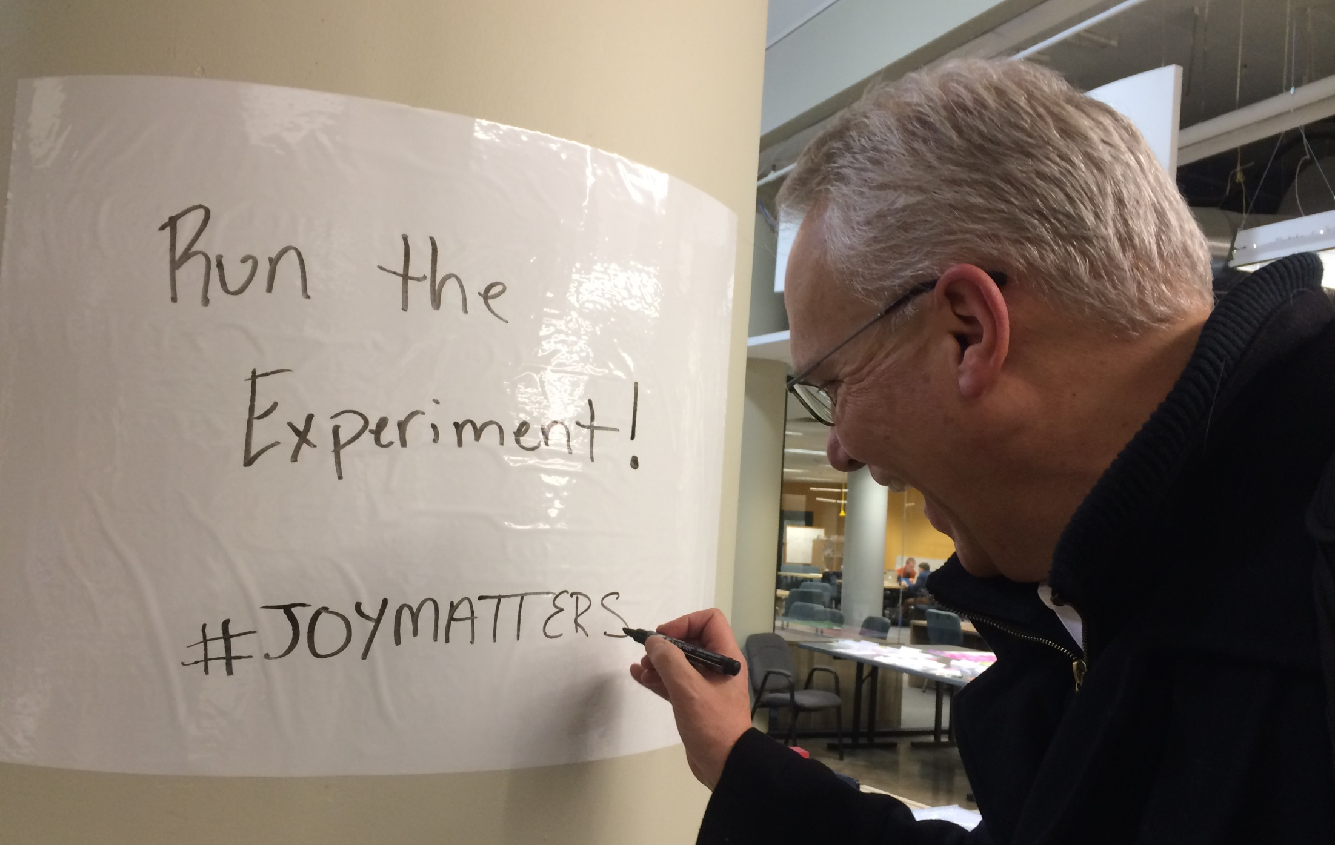

Slide 25
Thank you for coming to
The Power of Promiscuous Pairing
Get in touch with us
Carol Treat Morton
ctmorton@menloinnovations.com
Thomas Piggott
tpiggott@menloinnovations.com
@tjpiggott

